Slide 1

CS-3002: Information Security
Lecture # 11: Network Security Protocols and Defensive Mechanisms (Firewall, IDS, DNSSEC, DDoS)
Prof. Dr. Sufian Hameed
Department of Computer Science
FAST-NUCES

Slide 2
This Lecture
Firewall
Intrusion Detection System (IDS)
DNSSEC
Distributed Denial Of Service (DDoS)

Slide 3
Firewall

Slide 4
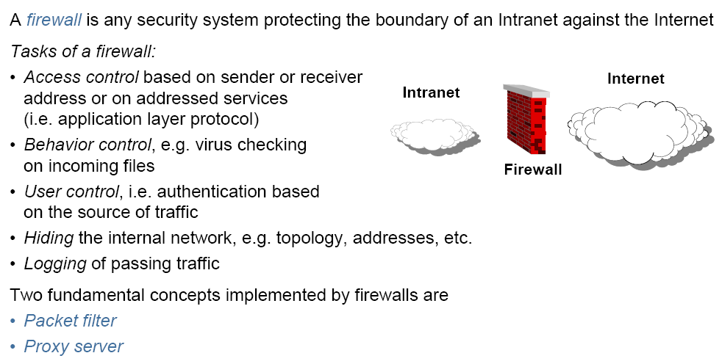
Firewall

Slide 5
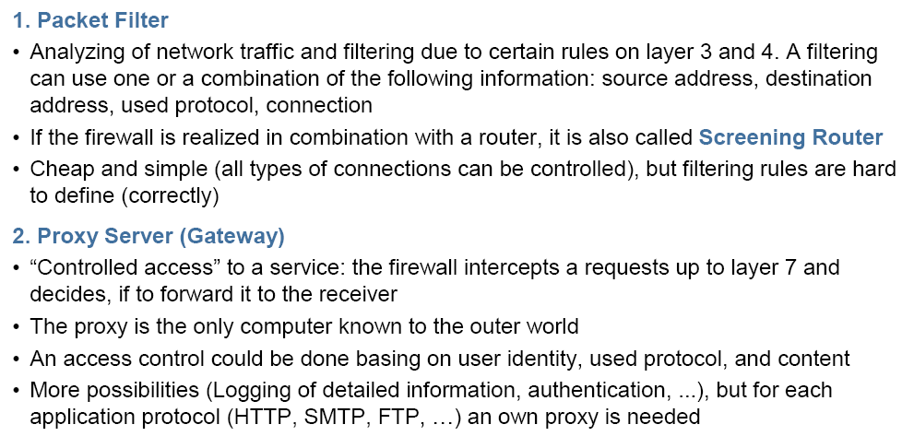
Types of Firewalls
Notes:
Firewall can also be a software at your PC. In Linux you can also define rules on IP Tables.

Slide 6
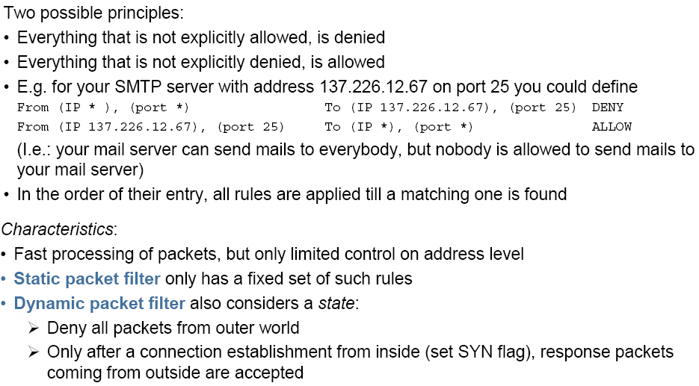
Packet Filter
Notes:
In computing, a stateful firewall (any firewall that performs stateful packet inspection (SPI) or stateful inspection) is a firewall that keeps track of the state of network connections (such as TCP streams,UDP communication) traveling across it. The firewall is programmed to distinguish legitimate packets for different types of connections. Only packets matching a known active connection will be allowed by the firewall; others will be rejected.

Slide 7
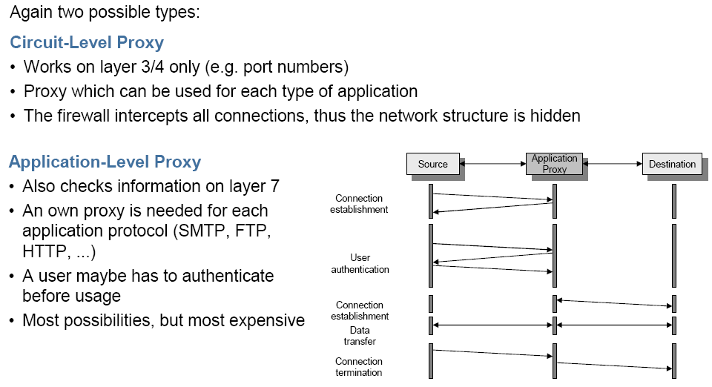
Proxy Server

Slide 8
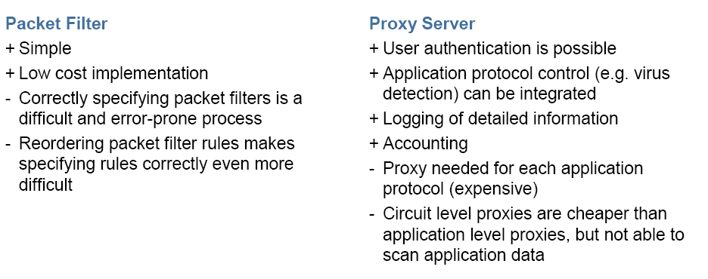
Packet Filter vs Proxy Server

Slide 9
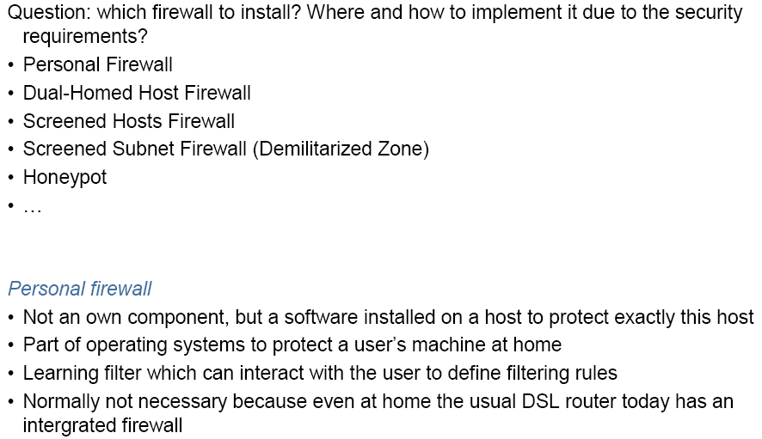
Security Architectures

Slide 10
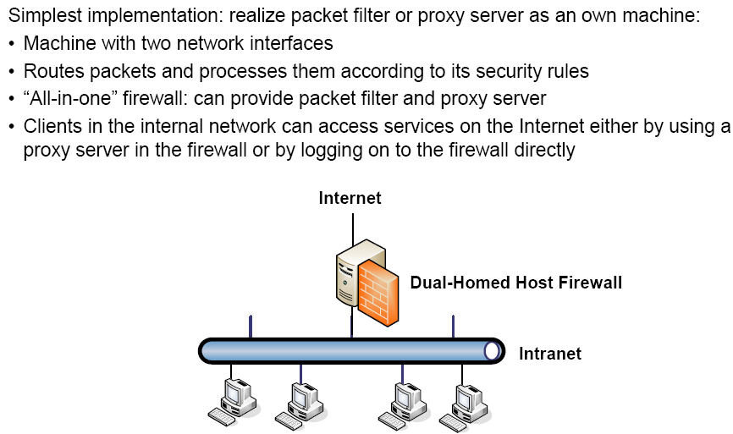
Dual-Homed Host Firewall
Notes:
A dual-homed host (or dual-homed gateway^{[1]}) is a system fitted with two network interfaces (NICs) that sits between an untrusted network (like the Internet) and trusted network (such as a corporate network) to provide secure access. Dual-homed is a general term for proxies, gateways, firewalls, or any server that provides secured applications or services directly to an untrusted network.

Slide 11
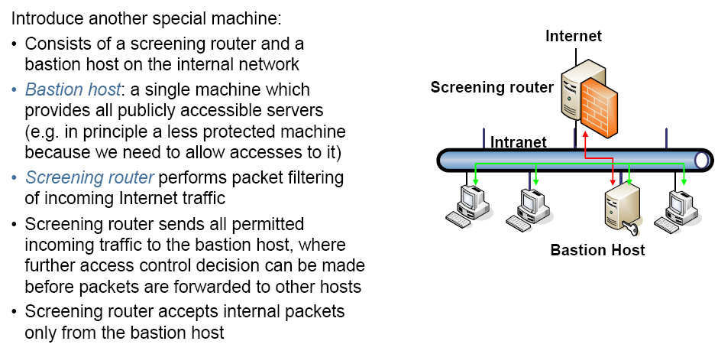
Screened Hosts Firewall

Slide 12
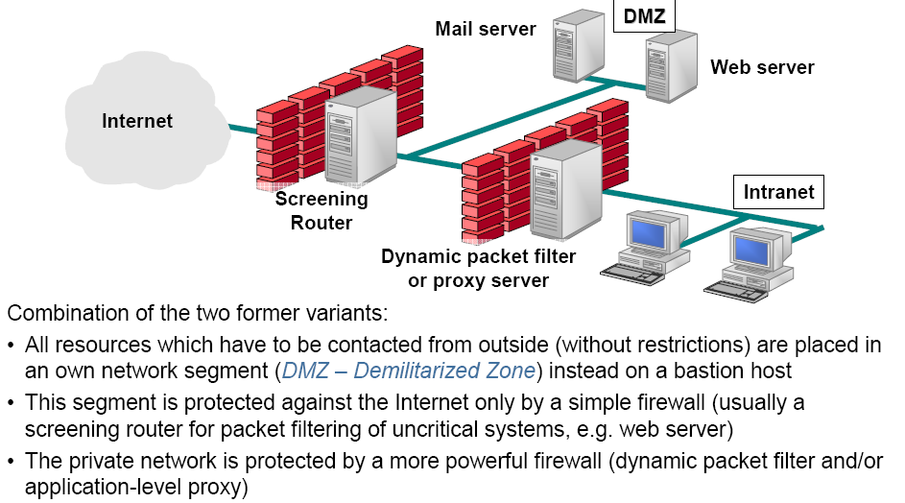
Demilitarized Zone

Slide 13
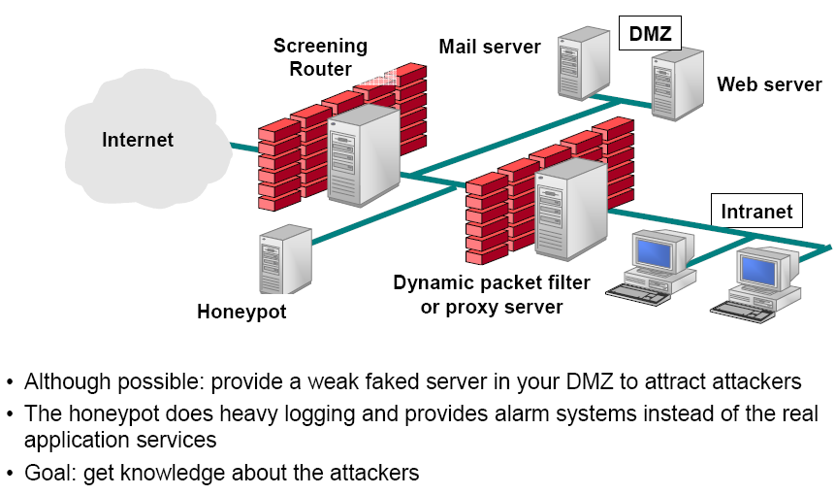
Additional: Honeypot

Slide 14
Intrusion Detection

Slide 15
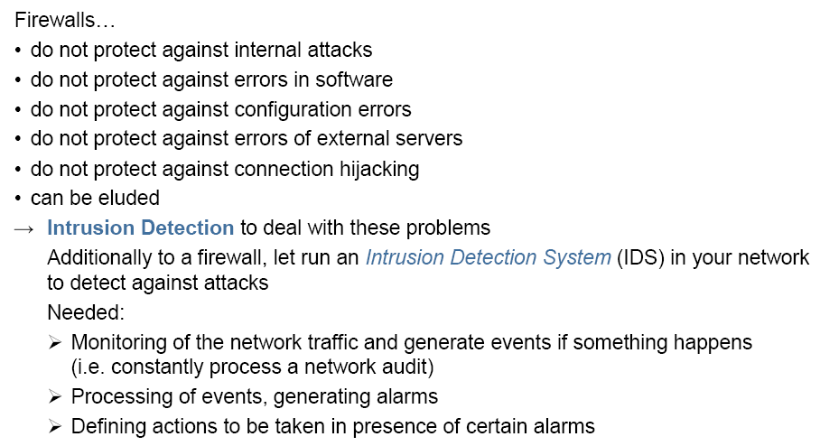
Intrusion Detection

Slide 16
Intrusion detection
Many intrusion detection systems
Close to 100 systems with current web pages
Network-based, host-based, or combination
Two basic models
Misuse detection model
Maintain data on known attacks
Look for activity with corresponding signatures
Anomaly detection model
Try to figure out what is “normal”
Report anomalous behavior
Fundamental problem: too many false alarms

Slide 17
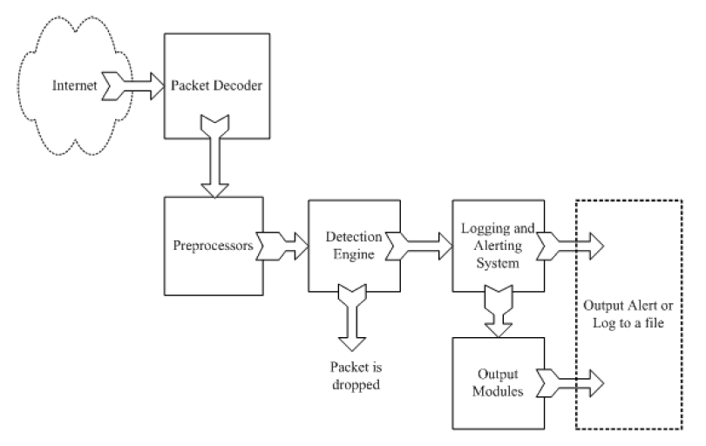
Example: Snort
http://www.snort.org/
From: Rafeeq Ur Rehman, Intrusion Detection Systems with Snort: Advanced IDS Techniques with Snort, Apache, MySQL, PHP, and ACID.

Slide 18
Snort components
Packet Decoder
input from Ethernet, SLIP, PPP…
Preprocessor:
detect anomalies in packet headers
packet defragmentation
decode HTTP URI
reassemble TCP streams
Detection Engine: applies rules to packets
Logging and Alerting System
Output Modules: alerts, log, other output

Slide 19
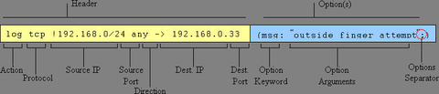
Snort detection rules
rule header
rule options

Slide 20
Snort challenges
Misuse detection – avoid known intrusions
Database size continues to grow
Snort version 2.3.2 had 2,600 rules
Snort spends 80% of time doing string match
Anomaly detection – identify new attacks
Probability of detection is low

Slide 21
Difficulties in anomaly detection
Lack of training data
Lots of “normal” network, system call data
Little data containing realistic attacks, anomalies
Data drift
Statistical methods detect changes in behavior
Attacker can attack gradually and incrementally
Main characteristics not well understood
By many measures, attack may be within bounds of “normal” range of activities
False identifications are very costly
Sys Admin spend many hours examining evidence

Slide 22
DNSSEC

Slide 23
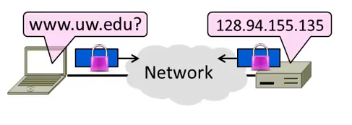
Topic
Securing Internet naming
DNS security extensions (DNSSEC)

Slide 24
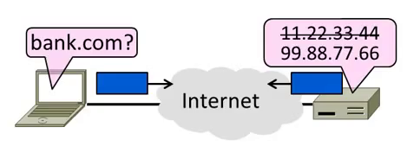
Goal and Threat Model
Naming is a crucial Internet service
Binds host name to IP address
Wrong binding can be disastrous …

Slide 25
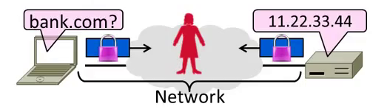
Goal and Threat Model (2)
Goal is to secure the DNS so that the returned binding is correct
Integrity/authenticity vs confidentiality
Attacker (Trudy) can intercept/tamper with messages on the network
Notes:
It is about integrity and Authenticity and not about confidentiality

Slide 26
DNS Spoofing
Hang on – how can a network attacker corrupt the DNS?
Trudy can trick a nameserver into caching the wrong binding
By using the DNS protocol itself
This is called DNS spoofing

Slide 27
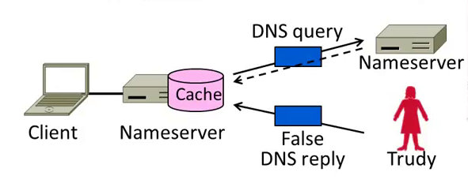
DNS Spoofing (2)
To spoof, Trudy returns a fake DNS response that appears to be true
Fake response contains bad binding

Slide 28
DNS Spoofing (3)
Lots of questions!
1. How does Trudy know when the DNS query is sent and what it is for?
2. How can Trudy supply a fake DNS reply that appears to be real?
3. What happens when the real DNS reply shows up?
There are solutions to each issue …

Slide 29
DNS Spoofing (4)
1. How does Trudy know when the query is sent and what it is for?
Trudy can make the query herself!
Nameserver works for many clients
Trudy is just another client
Notes:
Nameserver is a device that work on behalf of a pool of local clients. Trudy can really can act as one of those local clients. Often Nameserver don’t have access restrictions.

Slide 30
DNS Spoofing (5)
2. How can Trudy supply a fake DNS reply that appears to be real?
A bit more difficult. DNS checks:
Reply is from authoritative nameserver (e.g., .com)
Reply ID that matches the request
Reply is for outstanding query
• (Nothing about content though …)

Slide 31
DNS Spoofing (6)
2. How can Trudy supply a fake DNS reply that appears to be real?
Techniques:
Put IP of authoritative nameserver as the source IP address
ID is 16 bits (64K). Send many guesses! (Or if a counter, sample to predict.)
Send reply right after query
Good chance of succeeding!
Notes:
Normally network doesn’t check the source IP, so we can fake the IP

Slide 32
DNS Spoofing (7)
3. What happens when the real DNS reply shows up?
Likely not be a problem
There is no outstanding query after fake reply is accepted
So real reply will be discarded

Slide 33
DNSSEC (DNS Security Extensions)
Extends DNS with new record types
RRSIG for digital signatures of records
DNSKEY for public keys for validation
DS for public keys for delegation
First version in ‘97, revised by ’05
Deployment requires software upgrade at both client and server
Root servers upgraded in 2010
Followed by uptick in deployment

Slide 34
DNSSEC (2) – New Records
As well as the usual A, NS records
RRSIG
Digital signatures of domain records
DNSKEY
Public key used for domain RRSIGs (for validation of signatures)
DS
Public keys for delegated domain
NSEC/NSEC3
Authenticated denial of existence (answer from an authoritative NS that really there is no domain)
Notes:
A = ip Address
NS = Name Server
RRSIG = To check that the information in the record was correct
DS = Delegation Server record is used by one NameServer to tell you the PK of another NameServer.

Slide 35
DNSSEC (3) – Validating Replies
Clients query DNS as usual, then validate replies to check that content is authentic
Trust anchor is root public keys
Part of DNS client configuration
Trust proceeds down DNS hierarchy
Similar concept to SSL certificates

Slide 36
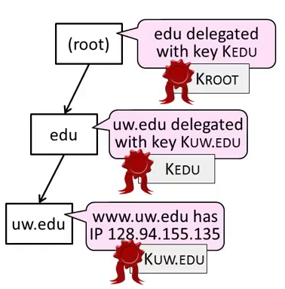
DNSSEC (4) – Validating Replies
Client queries www.uw.edu as usual
Replies include signatures/keys
Client validates answer:
1. KROOT is a trust anchor
2. Use KROOT to check KEDU
3. Use KEDU to check KUW.EDU
4. Use KUW.EDU to check IP

Slide 37
DNSSEC (5)
Other features too:
Authoritative answers a domain record doesn’t exist (NSEC/NSEC3)
Optional anti-spoofing to bind query and reply
Flags related to deployment …

Slide 38
Summary
DNS spoofing is possible without added security measures
Large problem in practice!
DNSSEC adds authentication (only) of replies to the DNS
Using a hierarchy of public keys

Slide 39
DNS Rebinding Attack
<iframe src="http://www.evil.com">
DNS-SEC cannot
stop this attack
Firewall
www.evil.com?
ns.evil.com
DNS server
171.64.7.115 TTL = 0
192.168.0.100
www.evil.com
web server
corporate
web server
171.64.7.115
192.168.0.100
Read permitted: it’s the “same origin”
[DWF’96, R’01]
Notes:
DNS rebinding is a form of computer attack. In this attack, a malicious web page causes visitors to run a client-side script that attacks machines elsewhere on the network. In theory, the same-origin policy prevents this from happening: client-side scripts are only allowed to access content on the same host that served the script. Comparing domain names is an essential part of forcing this policy, so DNS rebinding circumvents this protection by abusing the Domain Name System (DNS).
This attack can be used to breach a private network by causing the victim's web browser to access machines at private IP addresses and returning the results to the attacker. It can also be used to leverage the victim machine for spamming, distributed denial-of-service attacks and other malicious activities.
The attacker registers a domain (such as attacker.com) and delegates it to a DNS server he controls. The server is configured to respond with a very short time to live (TTL) record, preventing the response from being cached. When the victim browses to the malicious domain, the attacker's DNS server first responds with the IP address of a server hosting the malicious client-side code. For instance, he could point the victim's browser to a website that contains malicious JavaScript or Flash.
The malicious client-side code makes additional accesses to the original domain name (such as attacker.com). These are permitted by the same-origin policy. However, when the victim's browser runs the script it makes a new DNS request for the domain, and the attacker replies with a new IP address. For instance, he could reply with an internal IP address or the IP address of a target somewhere else on the Internet.

Slide 40
DNS Rebinding Defenses
Browser mitigation: DNS Pinning
Refuse to switch to a new IP
Interacts poorly with proxies, VPN, dynamic DNS, …
Not consistently implemented in any browser
Server-side defenses
Check Host header for unrecognized domains
Authenticate users with something other than IP
Firewall defenses
External names can’t resolve to internal addresses
Protects browsers inside the organization
Notes:
The following techniques attempt to prevent DNS rebinding attacks:
Web browsers can implement DNS pinning: the IP address is locked to the value received in the first DNS response. This technique may block some legitimate uses of Dynamic DNS, and may not work against all attacks.
Private IP addresses can be filtered out of DNS responses.
External public DNS servers with this filtering e.g. OpenDNS.^{[1]}
Local sysadmins can configure the organization's local nameservers to block the resolution of external names into internal IP addresses.
DNS filtering in a firewall or daemon e.g. dnswall.^{[2]}
Web servers can reject HTTP requests with an unrecognized Host header.
The Firefox NoScript extension provides partial protection (for private networks) using its ABE feature, which blocks web traffic from external addresses to local addresses.

Slide 41
DDoS

Slide 42
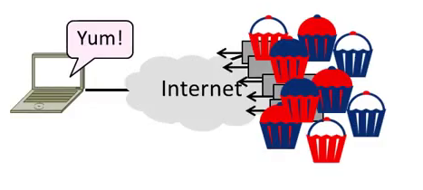
Topic
Distributed Denial-of-Service (DDOS)
An attack on network availability
Notes:
Very different kind of security problem. Confidentiality, Authentication don’t works

Slide 43
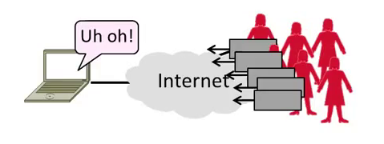
Topic
Distributed Denial-of-Service (DDOS)
An attack on network availability

Slide 44
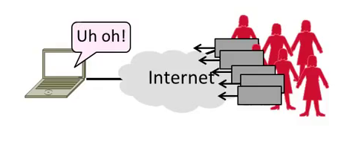
Motivation
The best part of IP connectivity
You can send to any other host
The worst part of IP connectivity
Any host can send packets to you!

Slide 45
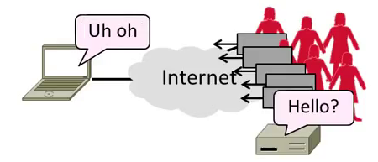
Motivation (2)
Flooding a host with many packets can interfere with its IP connectivity
Host may become unresponsive
This is a form of denial-of-service
Notes:
Because all the resource in the network are consumed

Slide 46
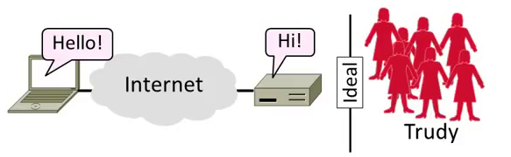
Goal and Threat Model
Goal is for host to keep network connectivity for desired services
Threat is Trudy may overwhelm host with undesired traffic

Slide 47
Internet Reality
Distributed Denial-of-Service is a huge problem today!
Akamai Q3-12 reports DDOS against US banks peaking at 65 Gbps of traffic flooding the bank
There are no great solutions
CDNs, network traffic filtering, and best practices all help
Notes:
Akamai which monitors the state of the internet.

Slide 48
Denial-of-Service
Denial-of-service means a system is made unavailable to intended users
Typically because its resources are consumed by attackers instead
In the network context:
“System” means server
“Resources” mean bandwidth (network) or CPU/memory (host)

Slide 49

Host Denial-of-Service
Strange packets can sap host resources!
“Ping of Death” malformed packet (bug the kernel and system crash)
“SYN flood” sends many TCP connect requests and never follows up
Few bad packets can overwhelm host
Patches exist for these vulnerabilities
Read about “SYN cookies” for interest
Notes:
You can send a ping packet and it is formed in such a way that it will create a kernel bug and crash the system.
SYN Flood used to work in the old days.
Patches for ping of death are also available. SYN Cookies are a defense of SYN Flood.

Slide 50
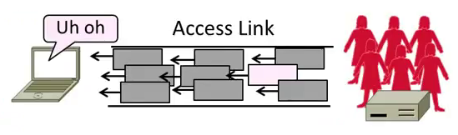
Network Denial-of-Service
Network DOS needs many packets
To saturate network links
Causes high congestion/loss
Helpful to have many attackers or Distributed Denial-of-Service
Notes:
Simply send enough network to saturate the network

Slide 51
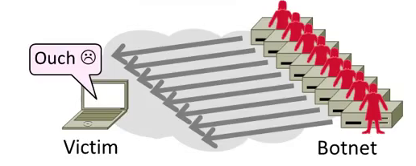
Distributed Denial-of-Service (DDoS)
Botnet provides many attackers in the form of compromised hosts
Hosts send traffic flood to victim
Network saturates near victim
Notes:
Access link for the victim will be saturated.
On top of that the attacker will also spoof the IP source address

Slide 52
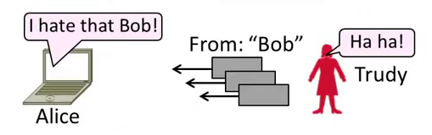
Complication: Spoofing
Attackers can falsify their IP address
Put fake source address on packets
Historically network doesn’t check
Hides location of the attackers
Called IP address spoofing

Slide 53
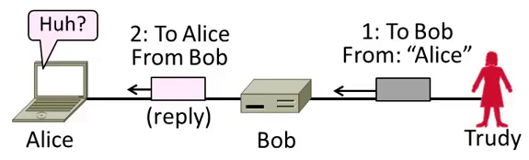
Spoofing (2)
Actually, it’s worse than that
Trudy can trick Bob into really sending packets to Alice
To do so, Trudy spoofs Alice to Bob

Slide 54
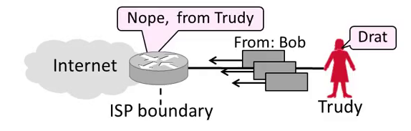
Best Practice: Ingress Filtering
Idea: Validate the IP source address of packets at ISP boundary (Duh!)
Ingress filtering is a best practice, but deployment has been slow
Notes:
We can stop most of these attacks

Slide 55
Flooding Defenses
1. Increase network capacity around the server; harder to cause loss
Use a CDN for high peak capacity
2. Filter out attack traffic within the network (at routers)
The earlier the filtering, the better
Ultimately what is needed, but ad hoc measures by ISPs today
Notes:
CDN is simply distributing the Content server at multiple location so you will get higher bandwidth at multiple locations

Slide 56
Acknowledgements
Material in this lecture are taken from the slides prepared by:
Prof. Dan Boneh (Standford)
Prof. O. Spaniol (RWTH Aachen)
Prof. David Wetheral (University of Washington)

